Slide 1
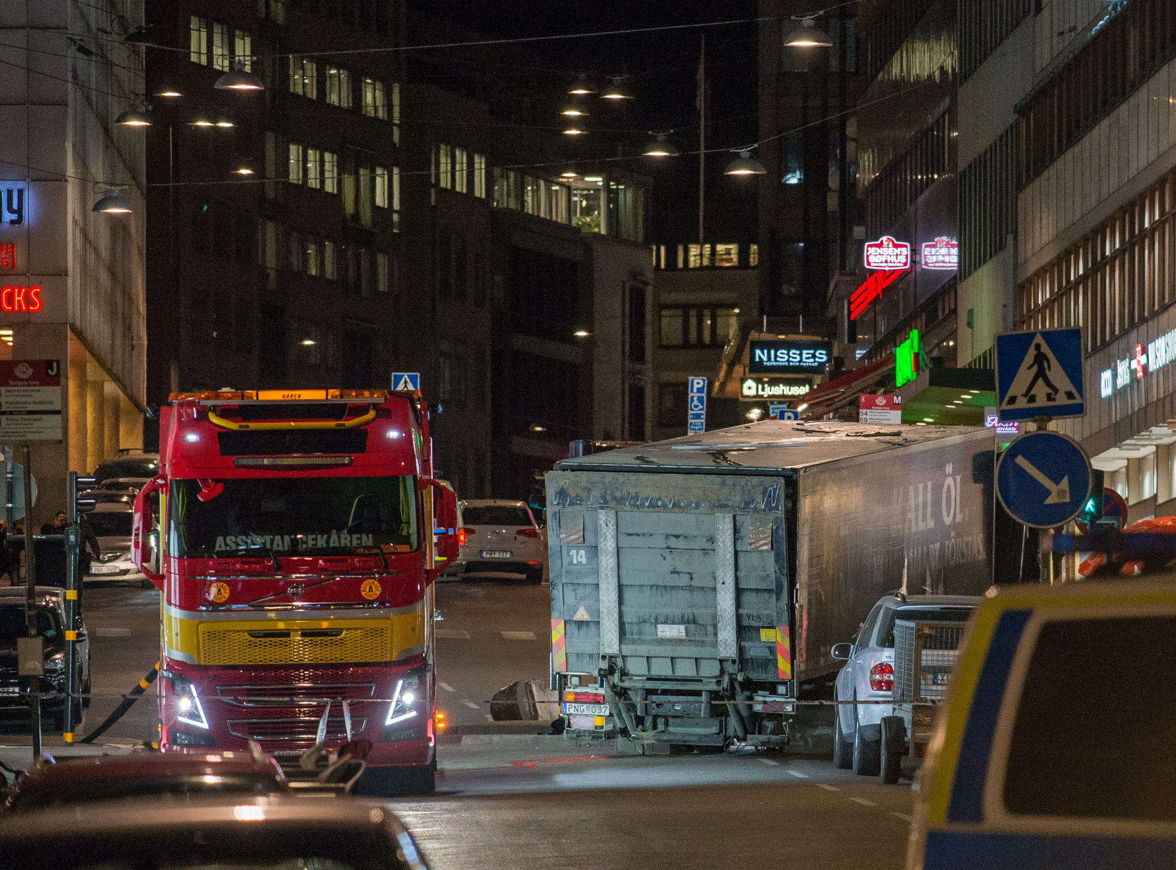
TERRORISM
The use of indiscriminate violence to spread fear in a bid to achieve political, religious, ideological or financial aims

Slide 2
STATS
Since 1970, there have been at least 3,395 terror-related deaths in the UK.
Most of these occurred in Northern Ireland.
Since 2001, there have been almost 100 deaths from terrorism in Great Britain.
Most of these were linked to Islamic extremism.
There were 166 arrests for terrorism-related activity in the year to March 2021 – 98 fewer than the year before.
The likelihood of anyone getting caught up in a terrorist attack remains small, but it’s still important to be vigilant.

Slide 3
BE VIGILANT
Like other criminals, terrorists need to plan. They must prepare, buy and store materials, and find ways to fund their activities.
Much of this is done in view of the public.
Counter Terrorism Policing would prefer you to report any activity you think may be suspicious, EVEN IF YOU ARE NOT SURE.
More than a fifth of the 30,984 reports to the police last year about suspected terrorist activity yielded useful intelligence. If you feel nervous about it – REPORT IT. Neil Basu, Counter Terrorism Policing Lead, says:
“We want all good citizens to be counter-terrorism citizens.”

Slide 4
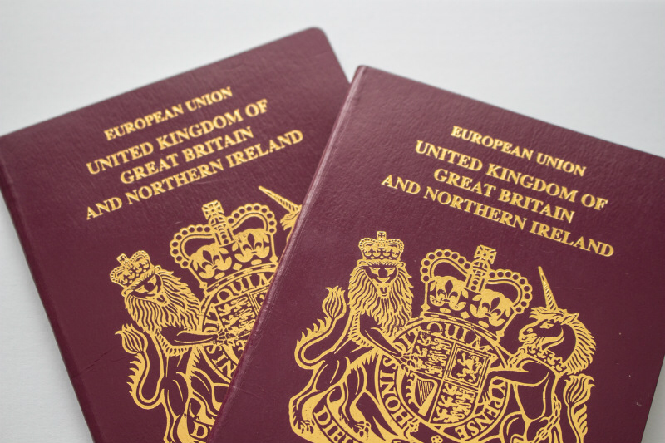
SPOTTING THE SIGNS
The research phase:
Someone has travel documents in different names for no obvious reason
Someone looks at, creates or shares extremist material online
Someone promotes hateful ideas or an extremist ideology
Someone travels a lot, but is vague about where they’re going and why

Slide 5
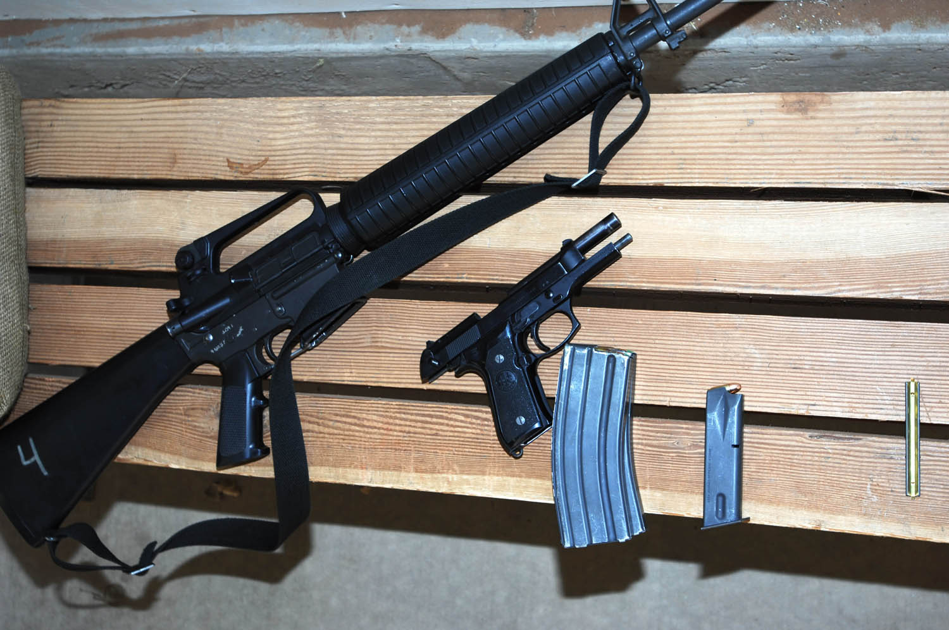
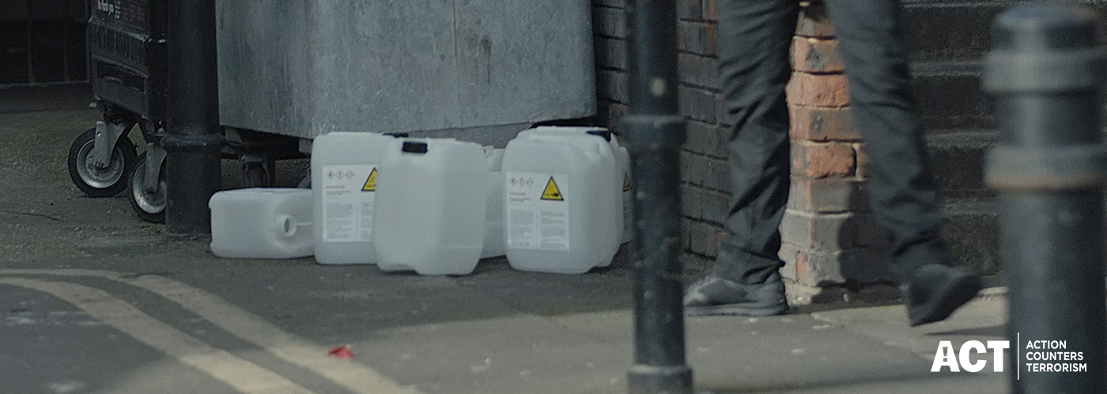
SPOTTING THE SIGNS
Gathering and storing materials:
Someone buys or receives deliveries of large quantities of chemicals, fertilisers or gas cylinders
Someone acquires, or tries to buy, firearms and other weapons

Slide 6
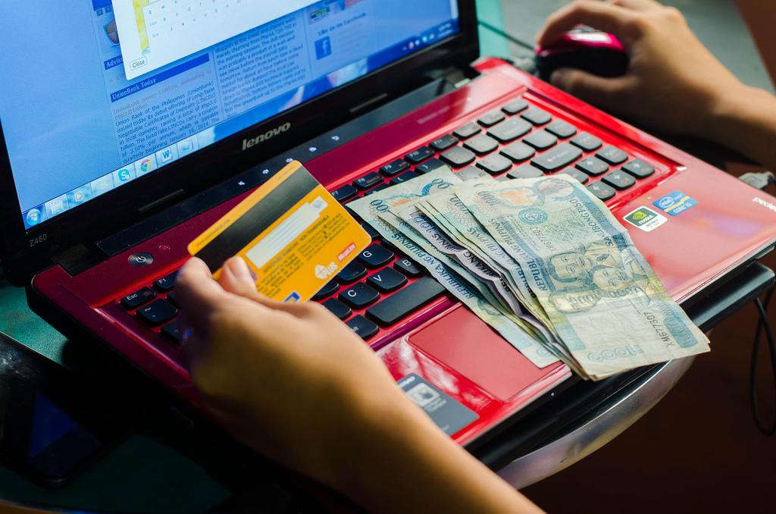
SPOTTING THE SIGNS
Observation and surveillance:
Financing:
Someone takes pictures or notes about security arrangements such as CCTV cameras, security personnel or exit signs
Cheque and credit card fraud can be used to generate cash. Have you noticed someone carrying out suspicious bank transactions?

Slide 7
WHAT SHOULD YOU DO?
If you’ve seen or heard something that doesn’t feel quite right, do not ignore it.
Report it! Action Counters Terrorism.
Report it online at www.gov.uk/ACT
OR
Call the police confidentially on 0800 789 321.
If you find content online that supports, directs or glorifies terrorism, you can report it anonymously online at www.gov.uk/report-terrorism.

Slide 8
WHAT WILL HAPPEN?
When you make a report about suspicious activity or behaviour, either online or over the phone, specially trained police staff will assess the information and decide how to proceed.
The information you provide will be kept secure and your identity will be protected.
The call is not recorded and you do not have to give your name.

Slide 9
COMMUNITIES DEFEAT TERRORISM
A short film from the Action Counters Terrorism campaign

Slide 10
ACT TO STAY SAFE
Counter Terrorism Policing has issued guidance setting out three key steps for keeping safe in the event of a firearms or weapons attack:

Slide 11
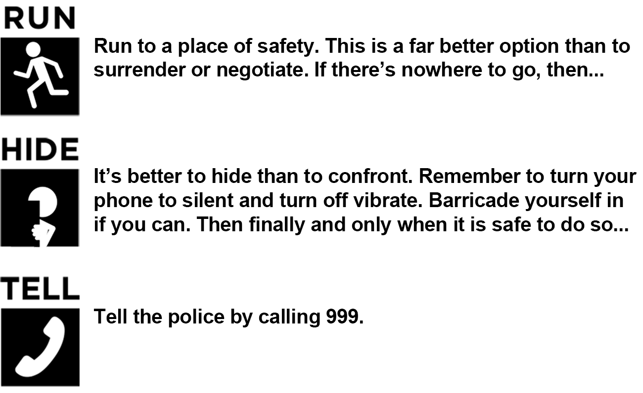
RUN, HIDE, TELL

Slide 12
FOR MORE INFO…
For more information, see https://www.ourwatch.org.uk/crimes-archive/terrorism/
and
https://act.campaign.gov.uk/
THANK YOU FOR LISTENING

